Slide 1
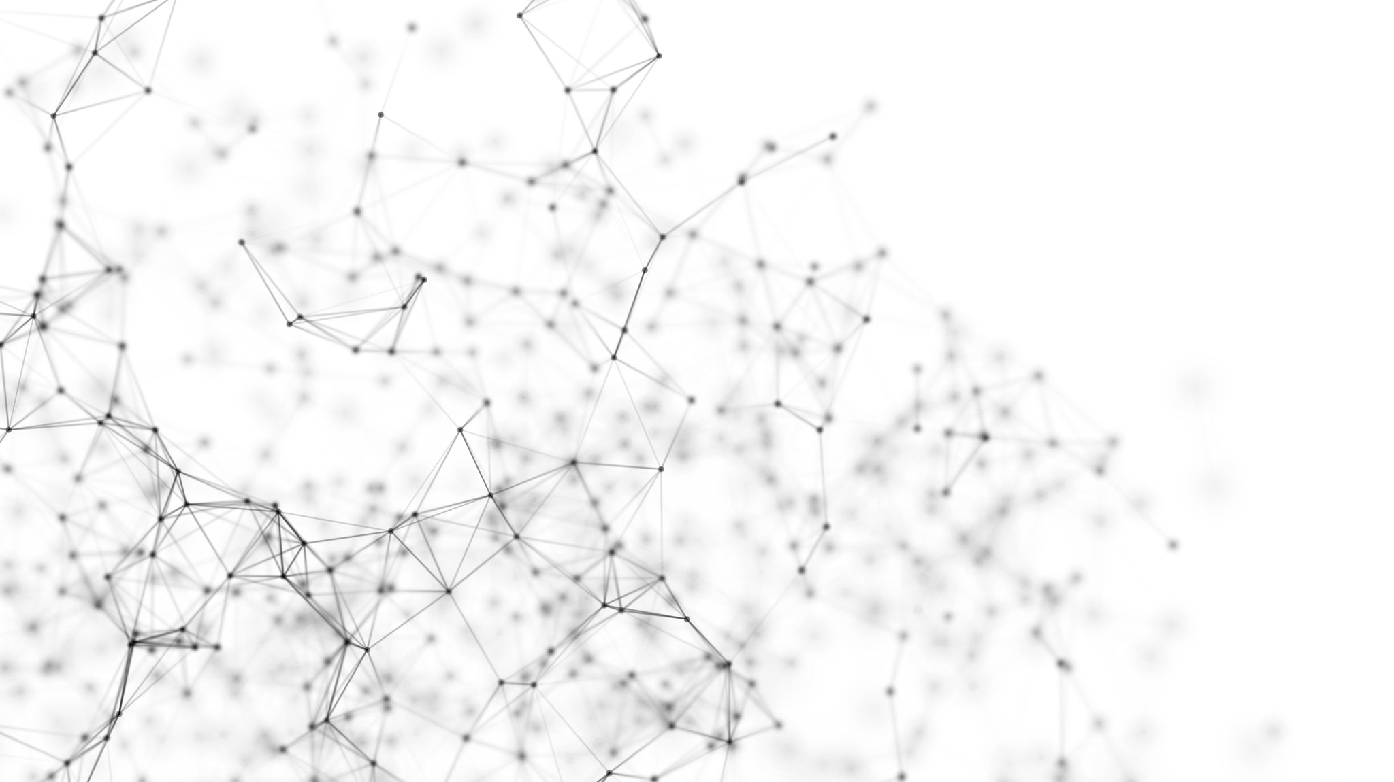
Personalized LLM

Slide 2
Why Personalization ?
The Challenge with Deploying LLMs:
Reduced Model Size for End Devices:
To deploy LLMs on edge or end devices, models are often reduced in size using techniques like quantization (converting weights from 32-bit precision to 8-bit or lower).
This reduction helps in optimizing memory usage, power consumption, and latency.
However, quantization reduces the precision of computations, leading to a drop in accuracy and performance.

Slide 3
Impact of Reduced Model Size:
Loss of Generalization: Smaller, quantized LLMs may struggle to handle diverse queries effectively, particularly in niche or specialized domains.
Decreased Contextual Understanding: Compression may limit the model’s ability to leverage its full potential in understanding complex or nuanced queries.
Why Personalization Solves This:
Compensates for Reduced Accuracy: Personalization ensures the model is tailored to specific tasks or domains, mitigating the impact of quantization on performance.
Smaller Models, Better Results: By integrating domain-specific knowledge or retrieval mechanisms, even small models can provide highly accurate and relevant responses.
Resource Efficiency: Personalization enables the use of lightweight models on resource-constrained devices without compromising user experience.

Slide 4
Ways to Personalize LLMs
Fine-Tuning
Updating the LLM’s internal weights using domain-specific data.
Ideal for highly specialized tasks but requires significant computational resources and time.
Example: Training a model to provide expert-level responses in a specific industry, such as legal or healthcare.
Retrieval-Augmented Generation (RAG)
Combines an LLM with an external database or document repository to retrieve relevant information dynamically.
Efficient and scalable, suitable for real-time, context-specific applications.
Example: Allowing users to query a knowledge base (e.g., company documentation or research papers) and generating precise answers based on the provided content.
Key Difference:
Fine-tuning embeds static knowledge into the model, while RAG dynamically retrieves and integrates external information, enabling flexibility and up-to-date responses.

Slide 5
Retrieval-Augmented Generation
A hybrid approach that combines:
Retrieval Module: Fetches relevant information from an external knowledge base or document repository.
Generation Module (LLM): Processes the retrieved data to generate a coherent and contextually relevant response.
Purpose: To enhance the LLM’s ability to handle specific, dynamic, or updated information without retraining the model.

Slide 6
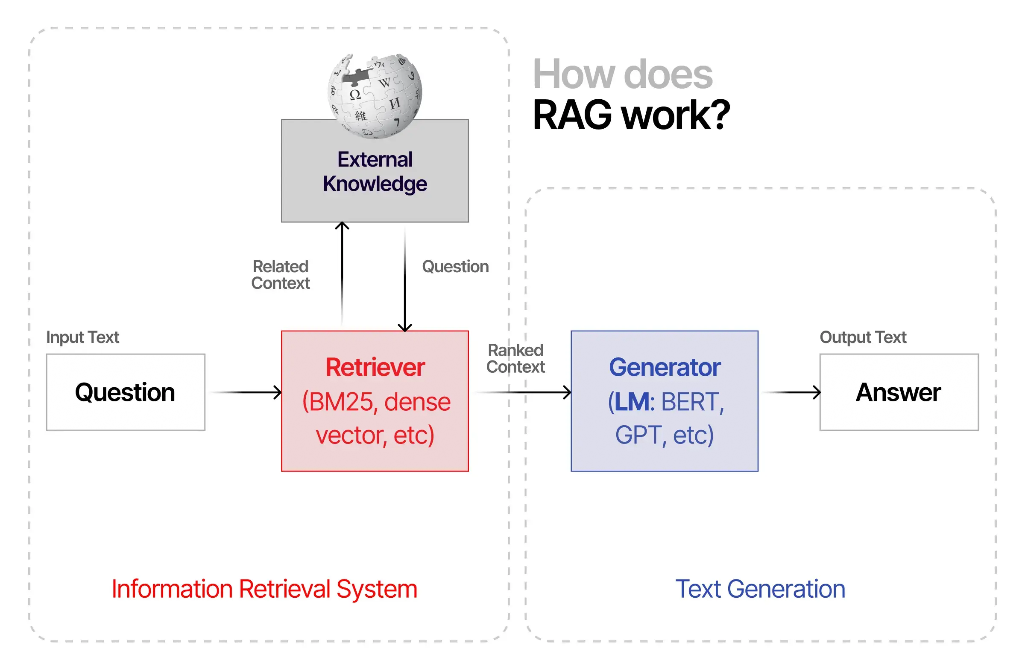

Slide 7
BUILDING A RAG SYSTEM

